Slide 1
MobileNetV2:
Inverted Residuals and Linear Bottlenecks
Mark Sandler, et al., “MobileNetV2: Inverted Residuals and Linear Bottlenecks”, CVPR 2018

Slide 2
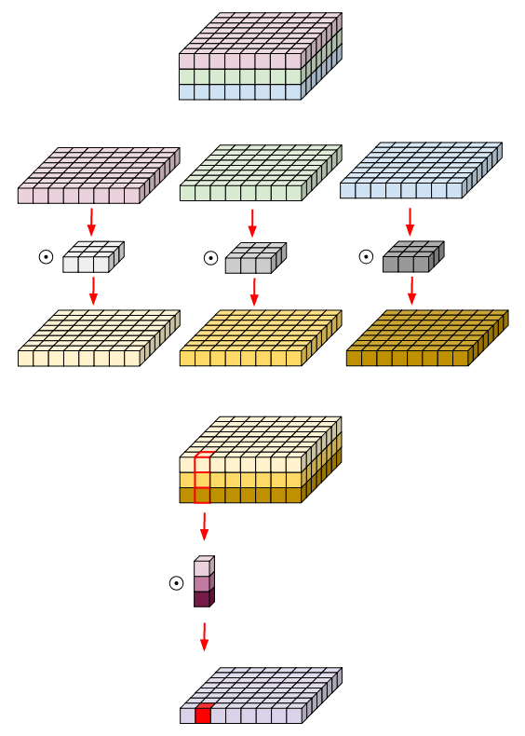
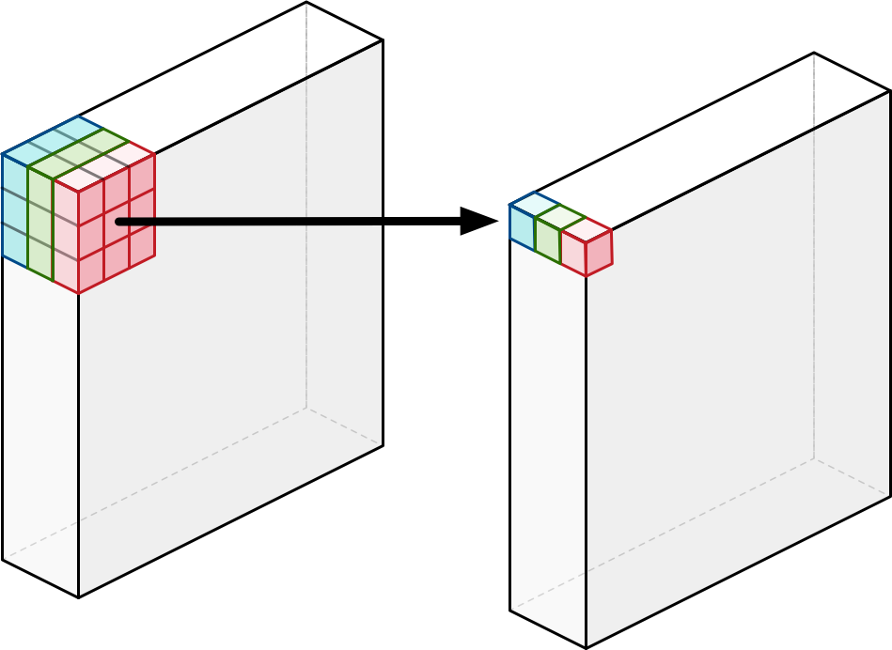
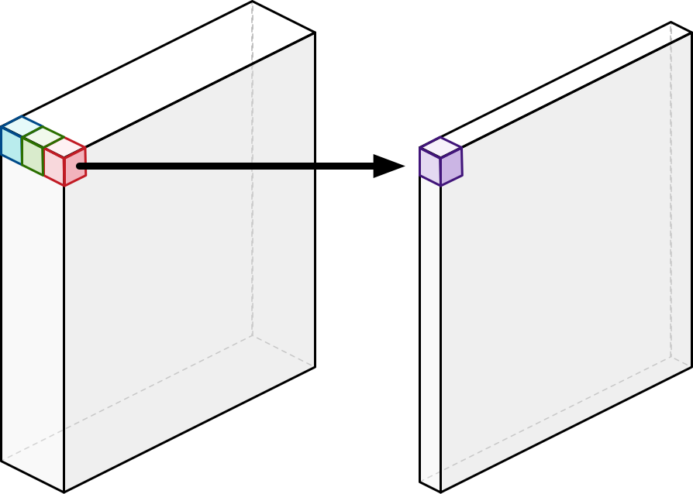
Recap – MobileNetV1
Depthwise Separable Convolution (depthwise conv + pointwise conv)
Depthwise convolution
Depthwise convolution
Pointwise convolution
Pointwise convolution
Figures from https://eli.thegreenplace.net/2018/depthwise-separable-convolutions-for-machine-learning/
http://machinethink.net/blog/googles-mobile-net-architecture-on-iphone/

Slide 3
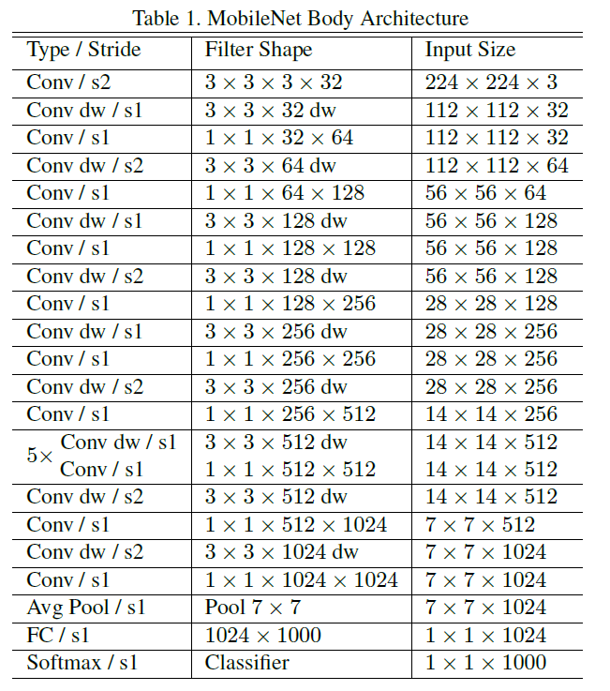
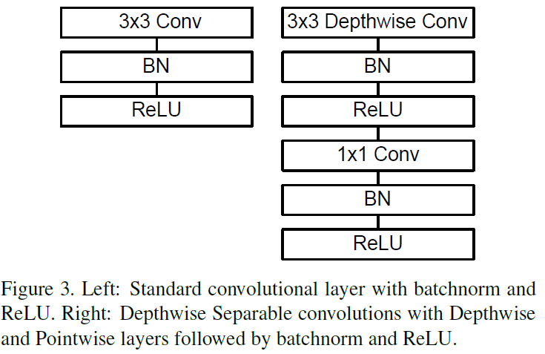
Recap – MobileNetV1

Slide 4
Key Features
Depthwise Separable Convolutions
Linear Bottlenecks
Inverted Residuals

Slide 5
Residual Blocks
wide → narrow(bottleneck) → wide approach

Slide 6
Inverted Residuals
narrow → wide → narrow approach

Slide 7
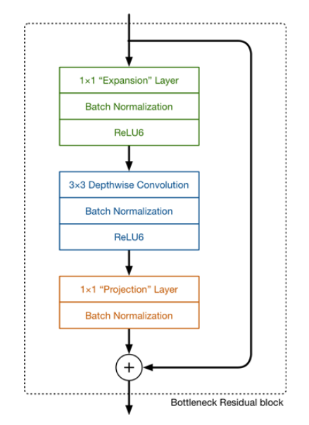
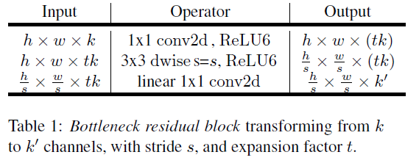
Bottleneck Residual Blocks
The basic building block is a bottleneck depth-separable convolution with residuals
Figures from http://machinethink.net/blog/mobilenet-v2/

Slide 8
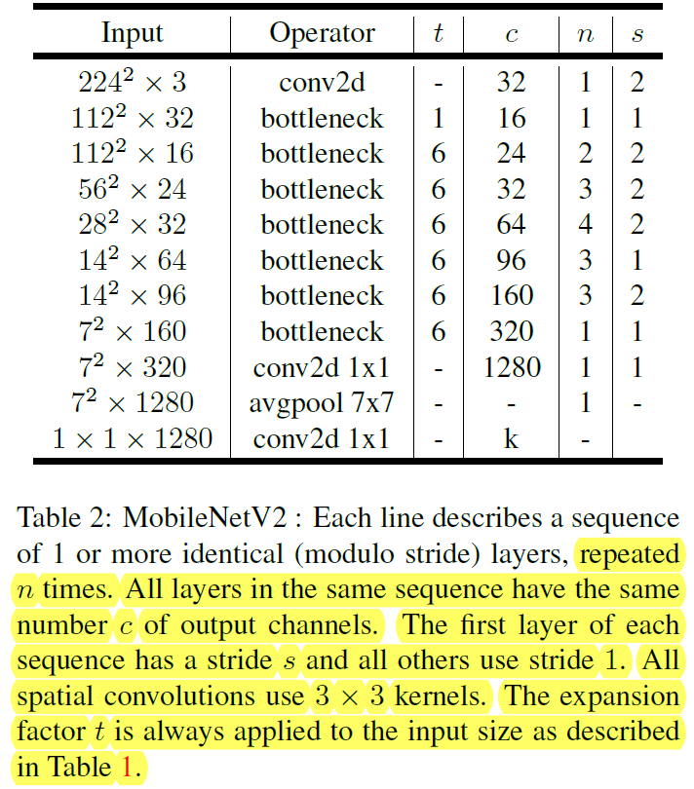
The Architecture of MobileNetV2
The architecture of MobileNetV2 contains the initial fully convolution layer with 32 filters, followed by 19 residual bottleneck layers described in the Table 2.

Slide 9
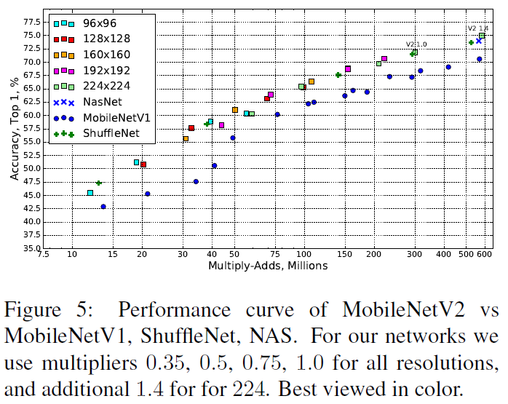
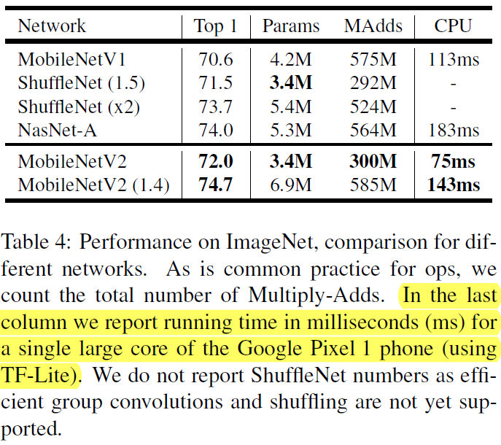
ImageNet Classification Results

Slide 10
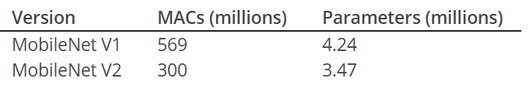
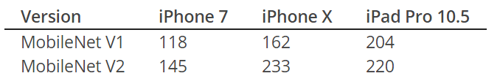
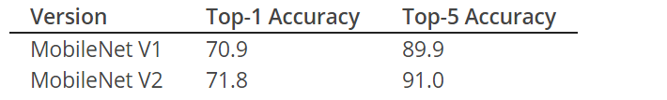
Vs MobileNetV1
Data from http://machinethink.net/blog/mobilenet-v2/

Slide 11
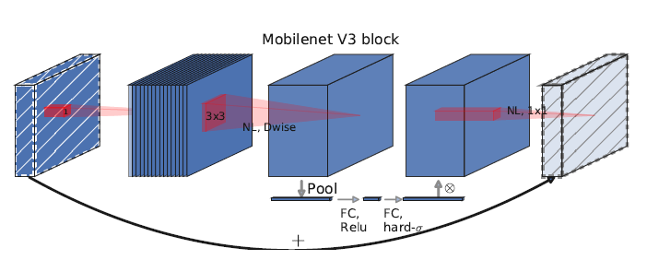

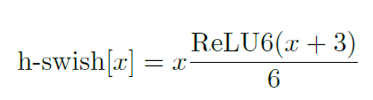
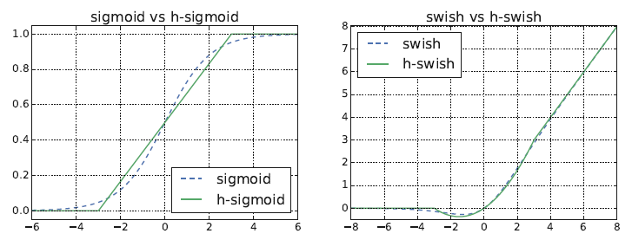
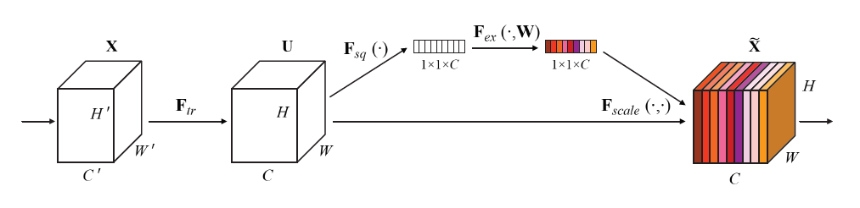
MobileNetV3

